Slide 1

P3- US Census Data
Big Data Cohort
https://github.com/2009-Big-Data-Revature/P3

Slide 2
Presentation Outline
Project Overview
Tech Overview
Data Overview
Challenges and Defects
Data Analysis
Retrospective
Q&A

Slide 3

Team Introduction
Scrum Master- Megan Hebert
Antonio Gomez
Benjamin Thiele
Darryl Bunn
Gerardo Torres
John Hughes
Jonathan Torres
Matthew Bernhardt
Michael Anderson
Miguel Pena
Oluwatobi Kolawole Olukunle
Robert Riggs
Sean Davis
Tony Erazo

Slide 4
Project Overview

Slide 5

Project Requirements
Load dataset into a python application
Remove irrelevant fields from the data
Create a database and data tables
Store the dataset on the cloud
Execute SQL queries to retrieve an initial summary of data
Create a visualization that contain summarizations so viewers can make quick assessments

Slide 6

Project Requirements: Queries to Answer
What is the total population of all U.S. states and territories?
Which region has the highest population annually?
What is the population of different categories?
Compare population differences between the years.
Predict a trend line for state populations in the next decade, based on past data.
Which regions are growing the fastest?
Which are the fastest-growing states?
Which areas are experiencing population decline?
Any other trends that you may find with the population data that could predict the future.

Slide 7

SCRUM/Agile Dev.
Agile methodologies facilitated consistent advancement in processing U.S. Census data with Spark
Daily meetings and weekly sprints helped the team navigate challenges, manage tasks, and sustain progress

Slide 8
Tech Overview

Slide 9




Tech Stack

Slide 10

Git
GitHub organization with the entire team
Main branch with shared resources
Each sub-team had own branch (eg. year_2000)
Within each team changes are either pushed directly to branch or to feature branch (eg. feature_2000/new-feature)
Feature branch to PR into team branch (eg. feature_2000/new-feature targets year_2000)

Slide 11
Data Overview

Slide 12

Redistricting Data Program
Public Law (P.L.) 94-171 requires the Census Bureau to provide states the opportunity to identify the small area geography for which they need data to conduct legislative redistricting.
This data is compiled and released every decade (2000, 2010, 2020, etc.)
The data consists of population data on a legislative district basis, including the demographic basis of the population.

Slide 13

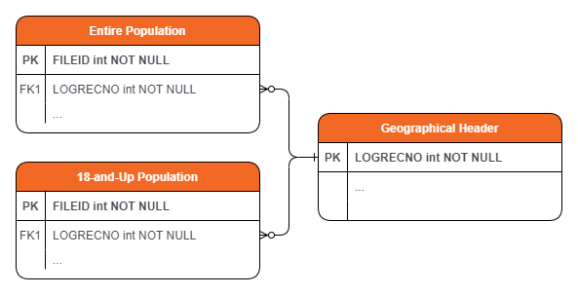
The Dataset
Size of Dataset for Each Decade
~ 13.5 GB
Size of Entire Dataset
~ 40 GB
Files for Each State:
Geo-header Data
Entire Population Data
18-and-Up Population Data

Slide 14
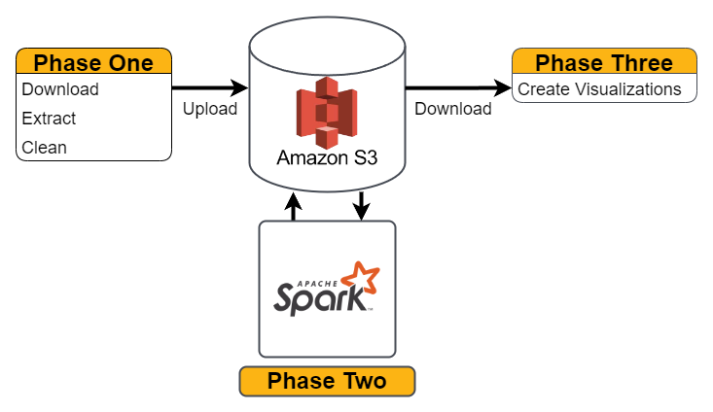
Architecture

Slide 15
Data Collection
Download and Un-Zip State File
Load the Contents of the Geo File into Pandas Data Frame.
Drop Unnecessary Columns and Filter Unnecessary Rows.
Parse Row Data If Necessary
Load the Contents of the Population File into a Data Frame.
Save Data to the Aggregated CSV File
Delete All of the Downloaded Files
Upload CSV to AWS S3 Bucket

Slide 16
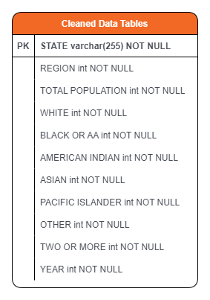

Entity Relationship Diagram

Slide 17
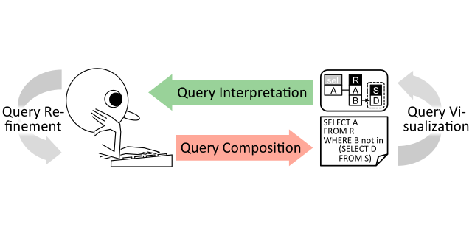
Spark Querying
Retrieve cleaned data CSV files.
Using PySpark and Spark SQL, we queried cleaned data to generate result sets tailored for each question.
Result sets are saved as CSV files and imported into PowerBI for visualization.

Slide 18
Challenges and Defects

Slide 19

Challenges Faced
Understanding how to access and use the redistricting data from the census website effectively.
Identifying which columns were relevant to our goals and the trends we wanted to show.
Choosing the best visualizations for the data and trends, ensuring they are professional and well-formatted.

Slide 20

Outstanding Defects/Issues
The data had columns on "Hispanic & Latino" and "Not Hispanic or Latino", however this data was troublesome because it represented a population that was well over the total population for a given state
For example, given Alabama's Population in 2000
Hispanic & Latino: 4,371,270
Not Hispanic or Latino: 4,332,184
Total Population: 4,447,100
Possible sources of error
Mislabeled columns

Slide 21
Data Analysis

Slide 22
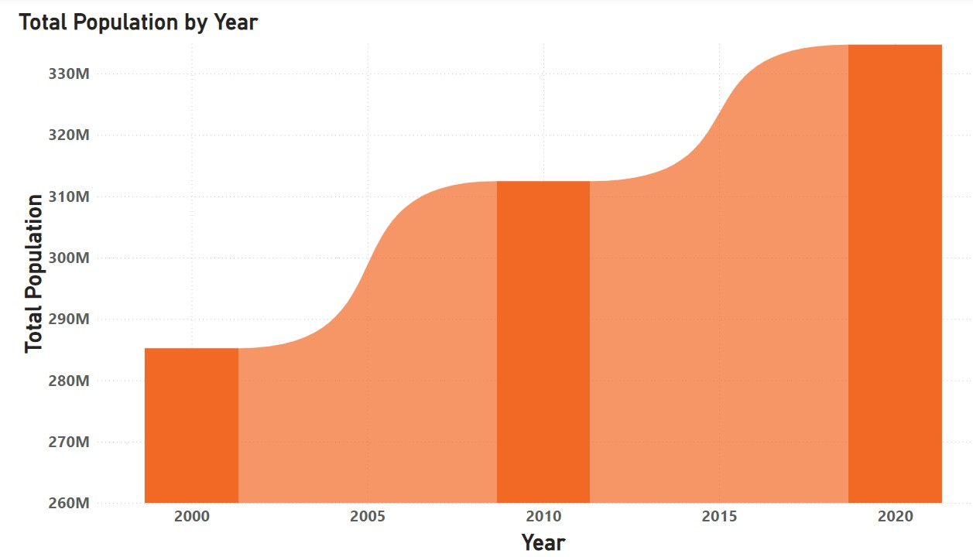
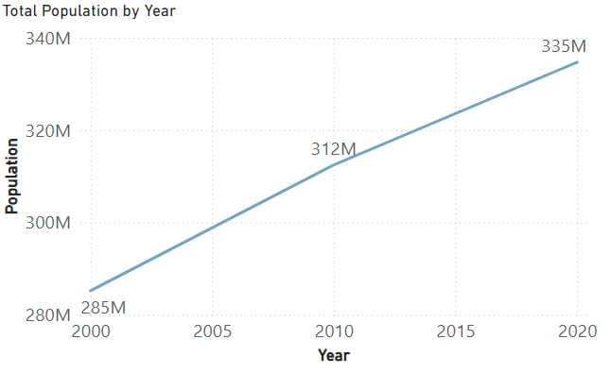
Total Population

Slide 23
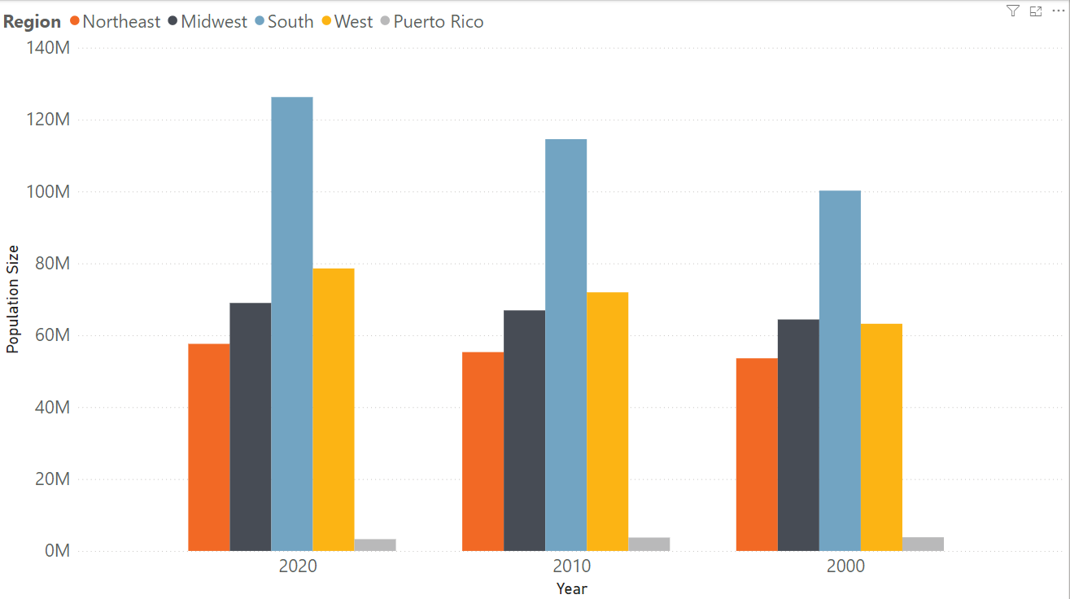
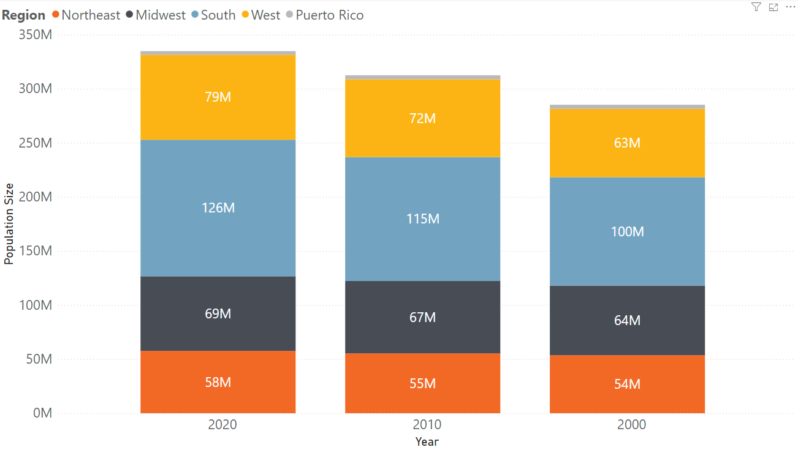
Highest Populated Region

Slide 24
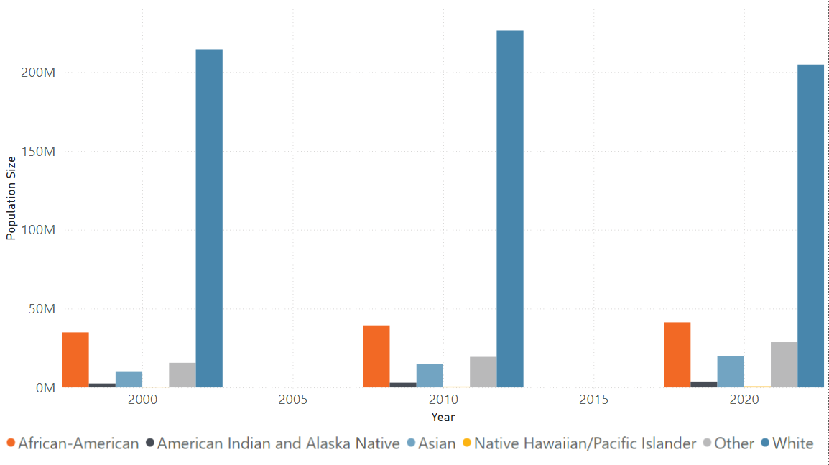
Categorical Populations

Slide 25
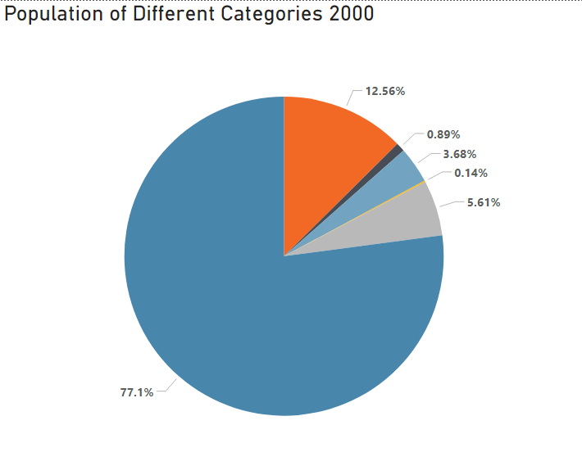
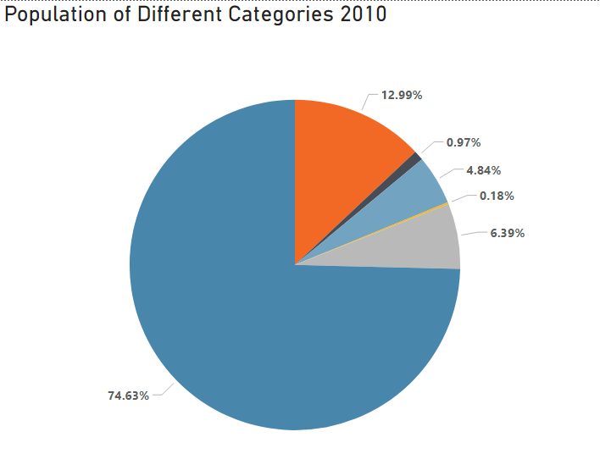
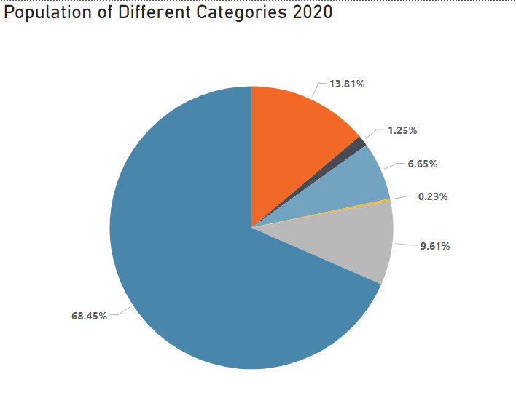
Categorical Populations

Slide 26
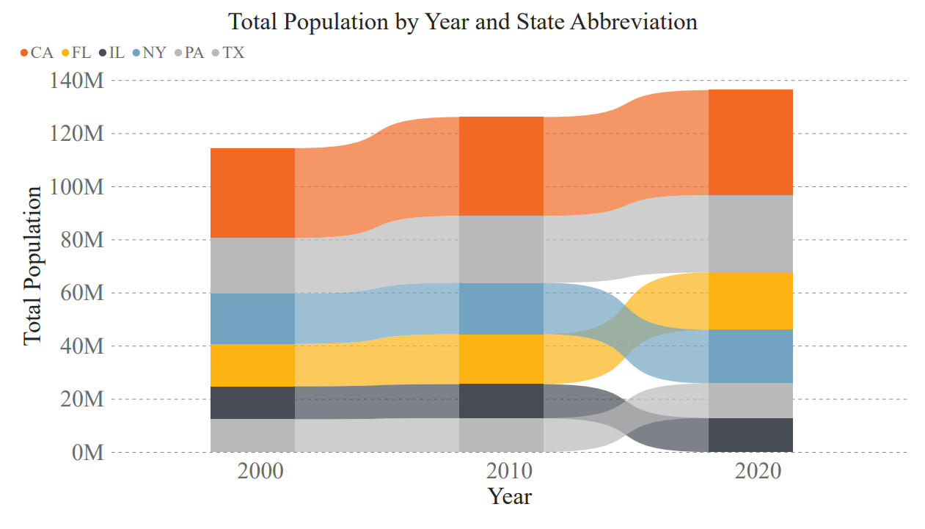
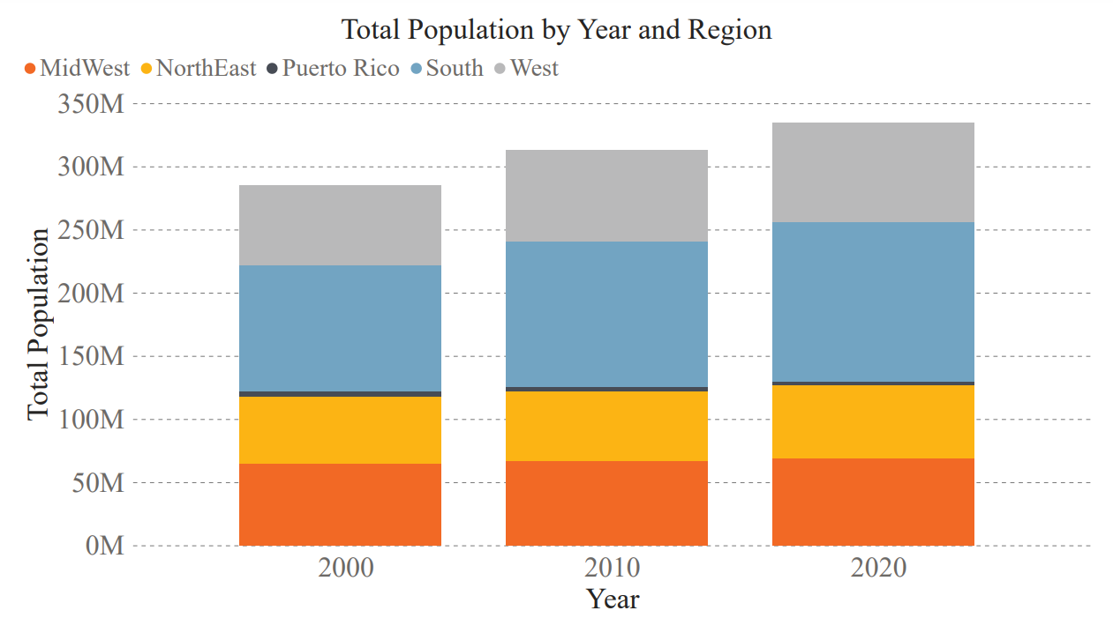
Population Comparison
State
Region

Slide 27
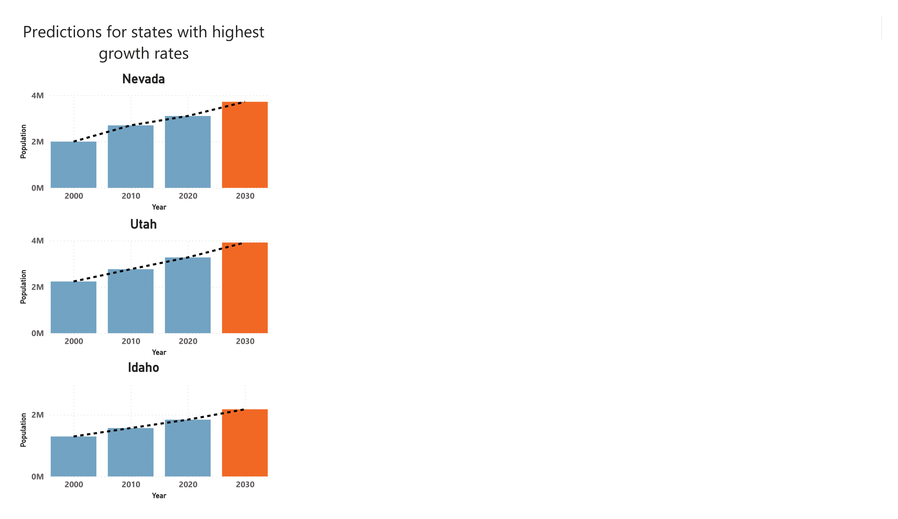
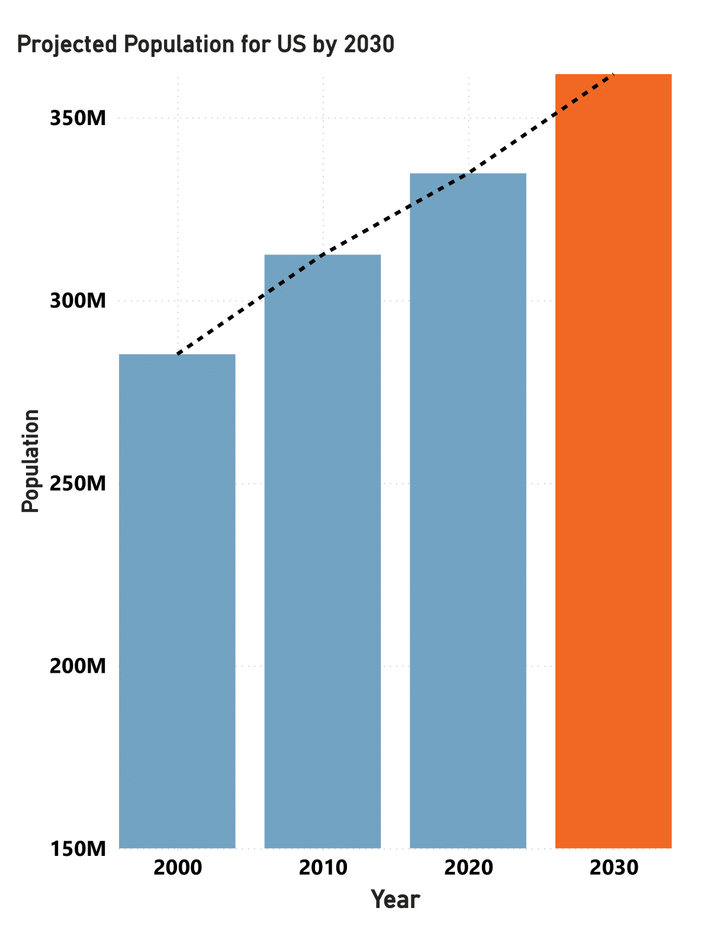
Trend Line Prediction
Estimated using exponential growth model, averaging data collected from the 3 decades
The United States population in 2020:
334 Million
Expected US population in 2030:
> 360 Million

Slide 28
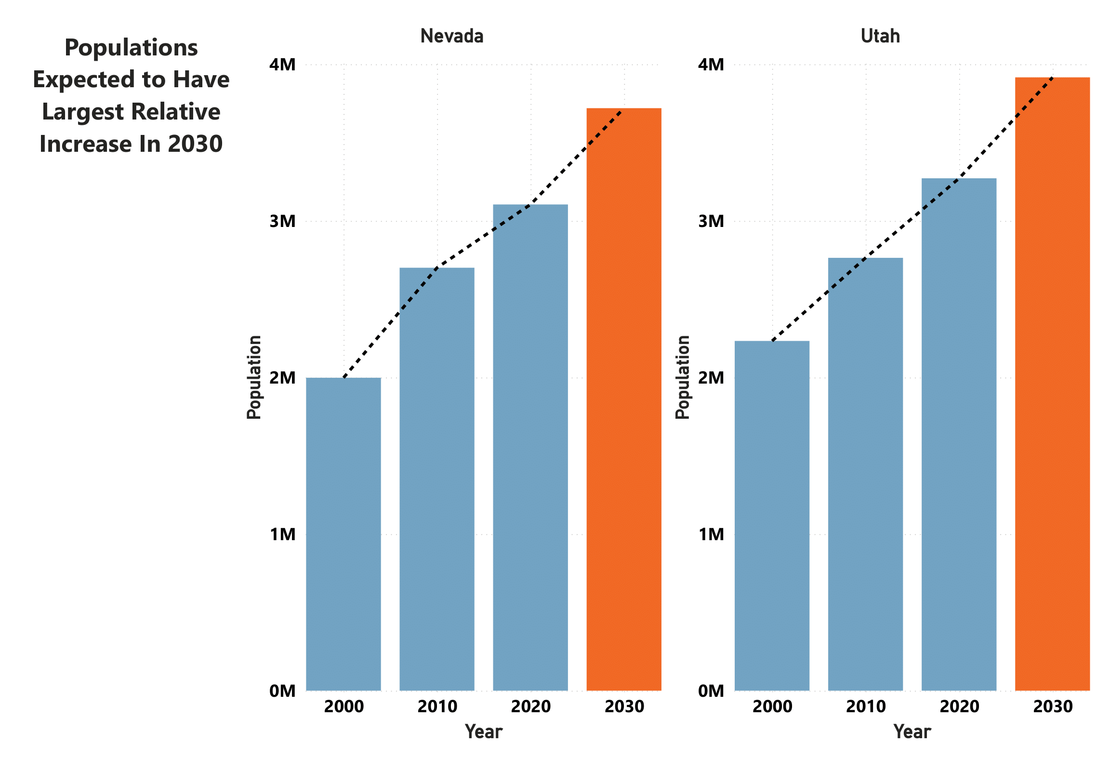
Trend Line Prediction
The states expected to see the most growth are neighboring states located in the west region:
Nevada
Utah

Slide 29
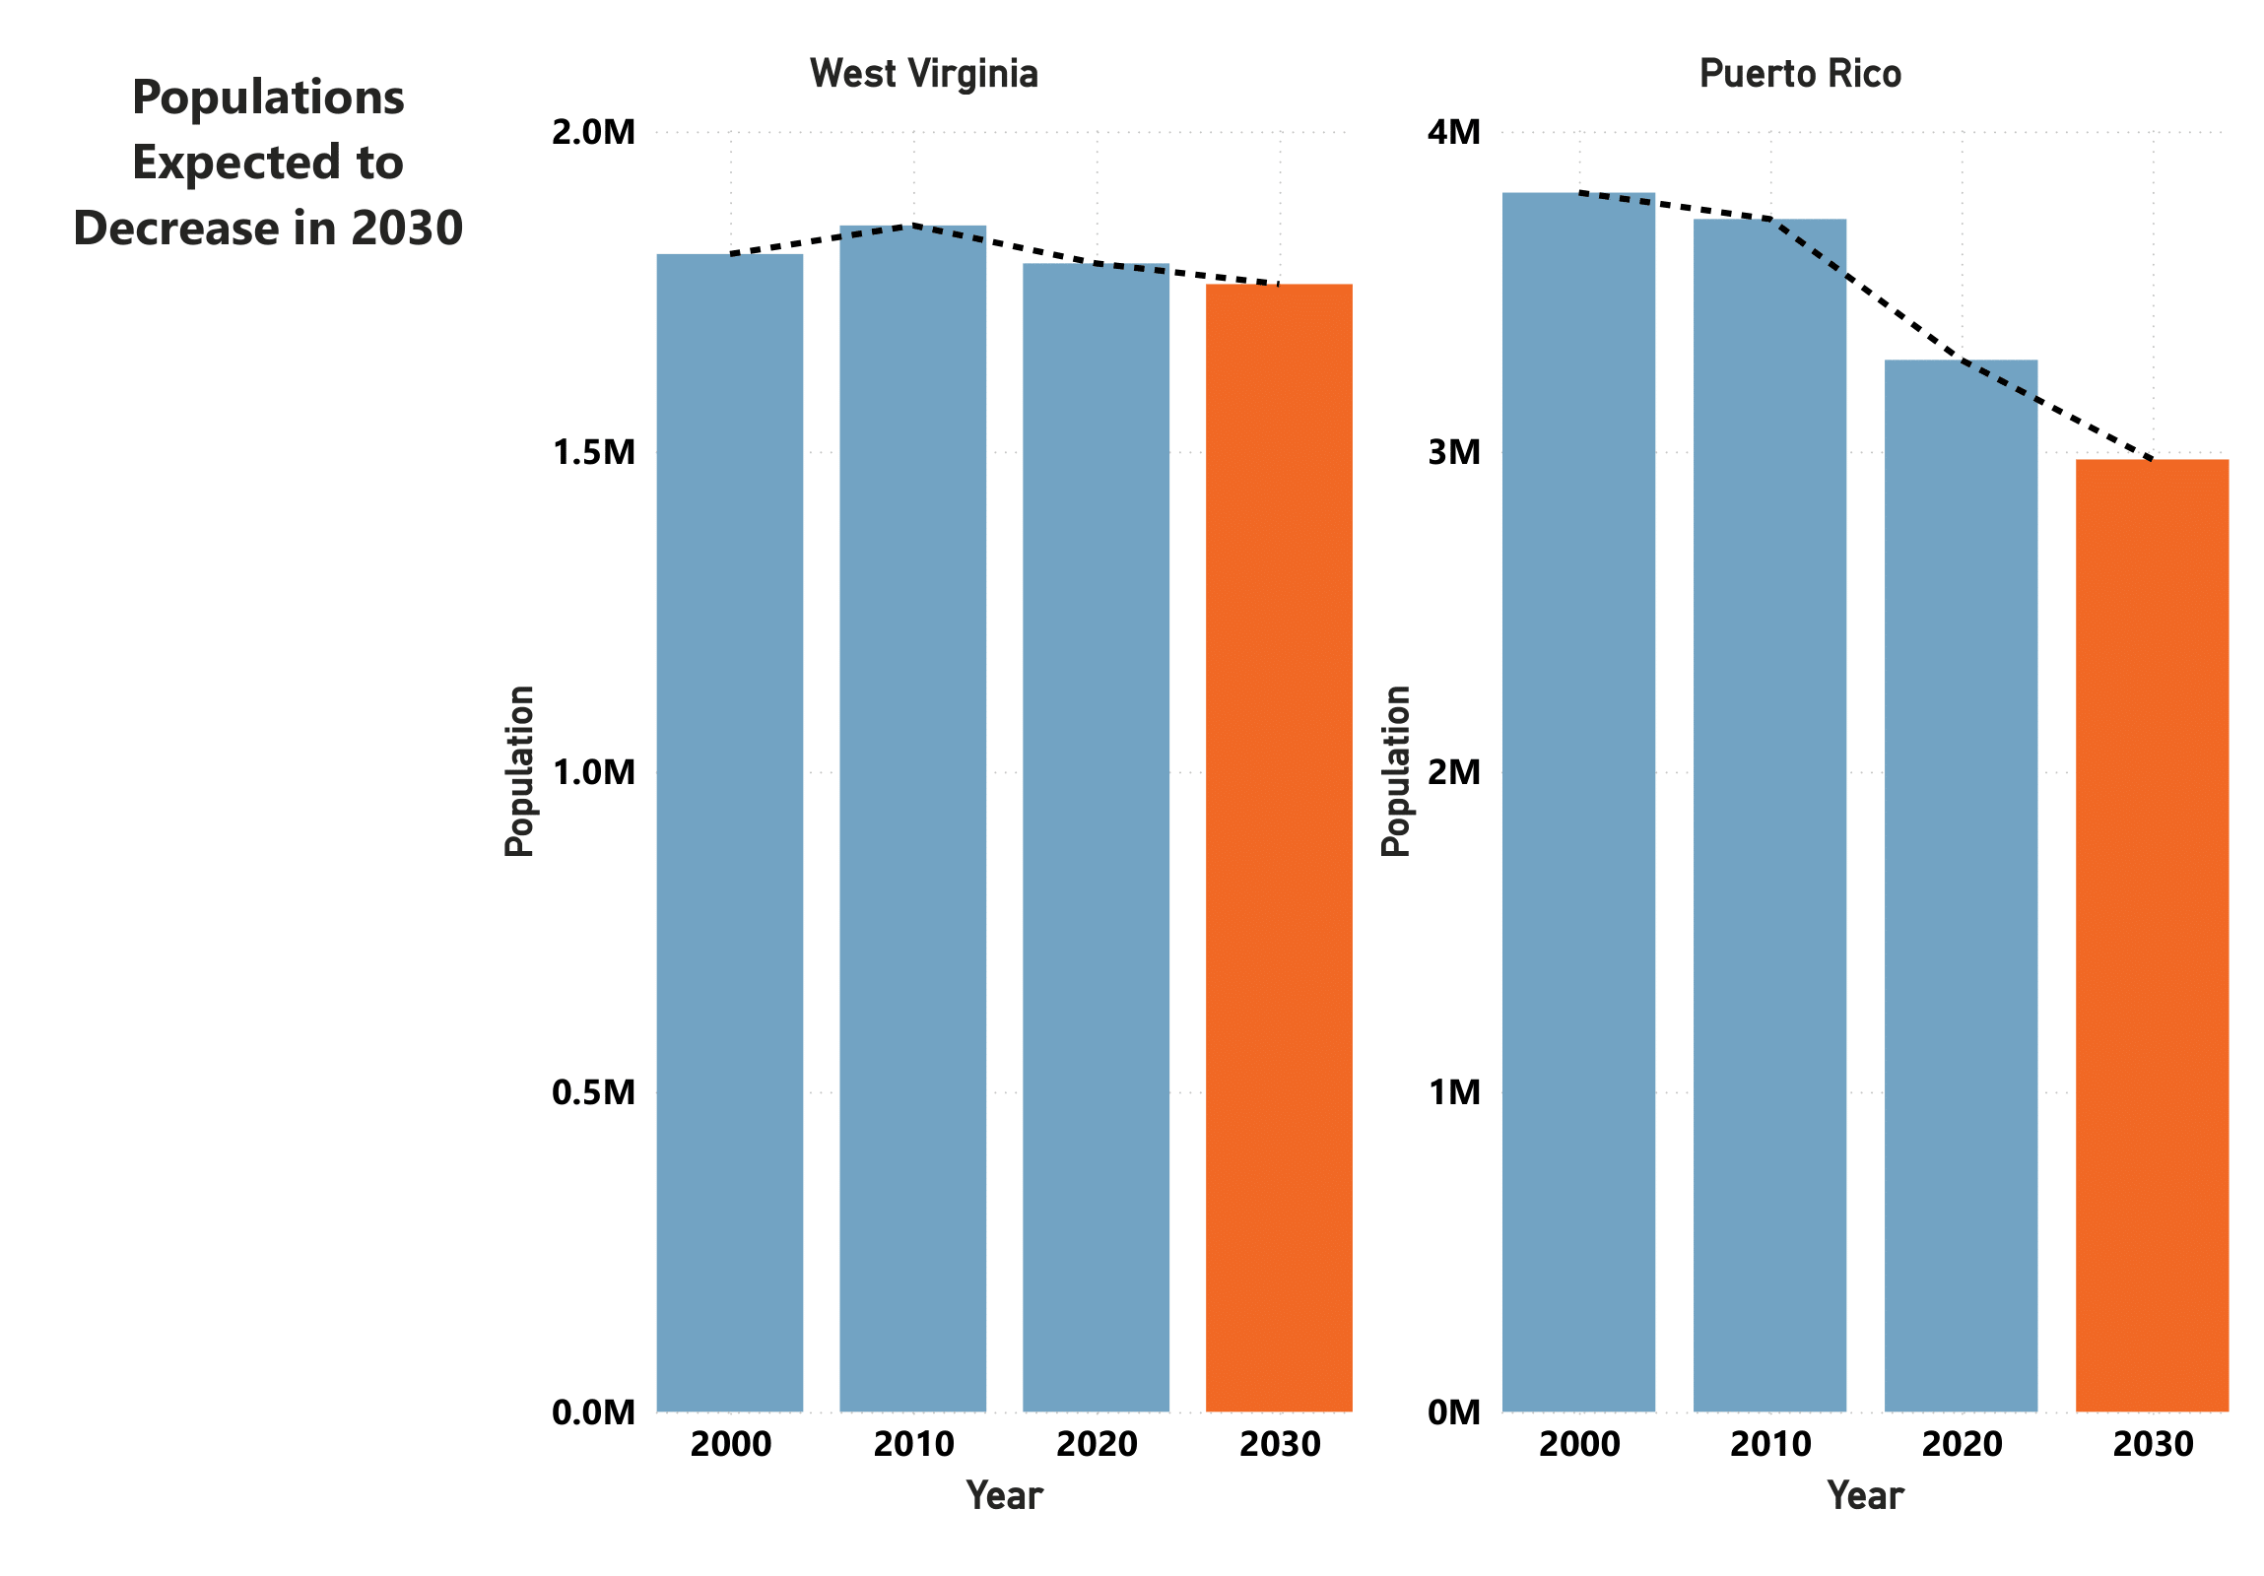
Trend Line Prediction
Only two US populations are expected to have a decline in population:
West Virginia
Puerto Rico

Slide 30
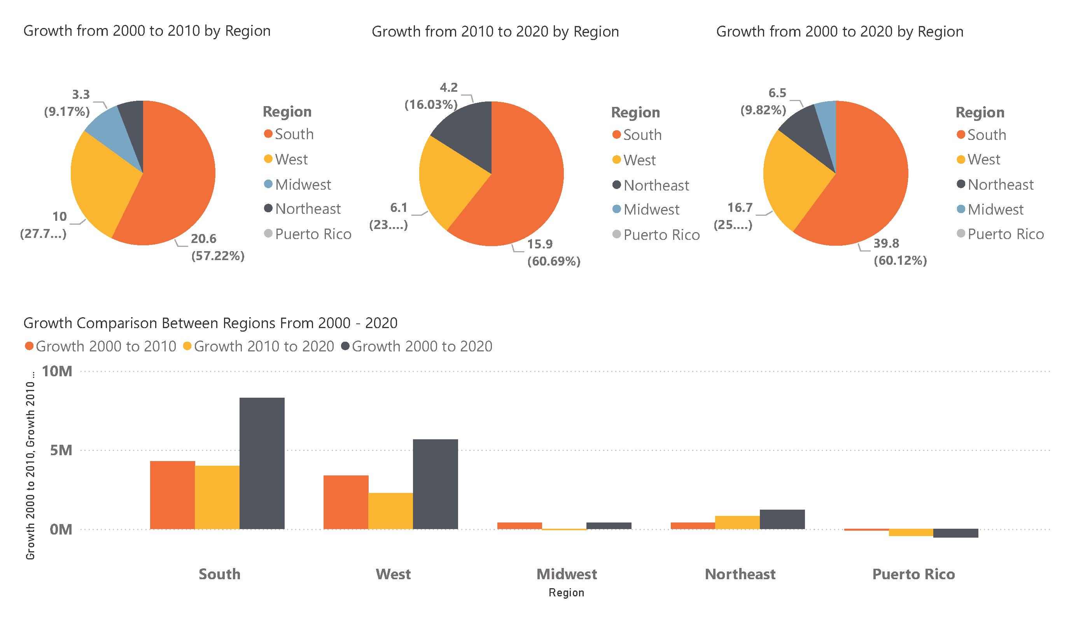
Fastest Growing Regions
Fastest Growing Regions
South 39.8%
West 25.23%
Puerto Rico experienced a negative change in its population

Slide 31
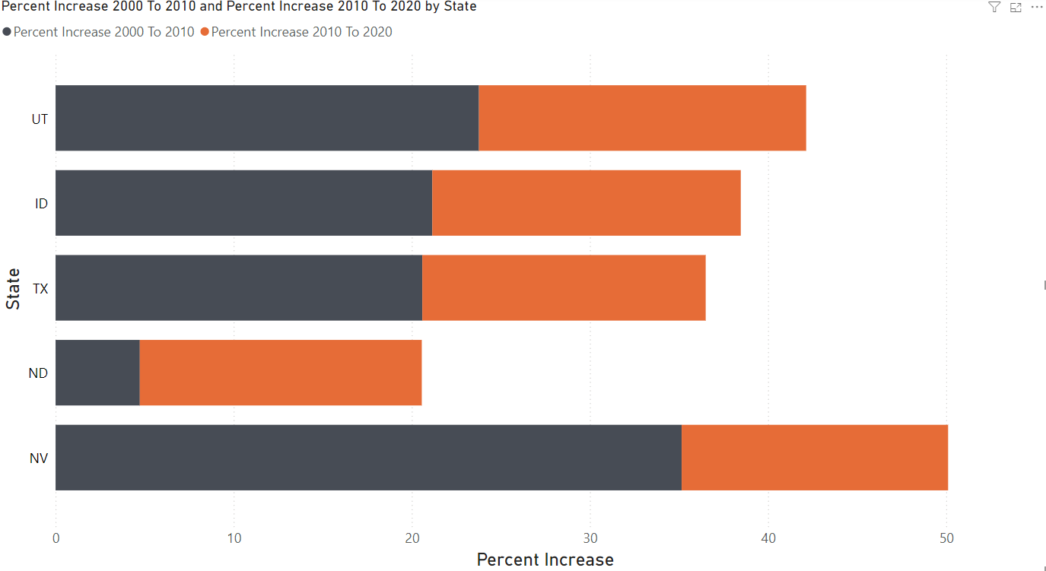
Fastest Growing States
Top 5 Current Fastest Growing States:
Utah – 18.37%
Idaho – 17.32%
Texas – 15.91%
North Dakota – 15.83%
Nevada – 14.96%
Utah was fastest growing state in 2020
Nevada had the most growth in last 20 years

Slide 32
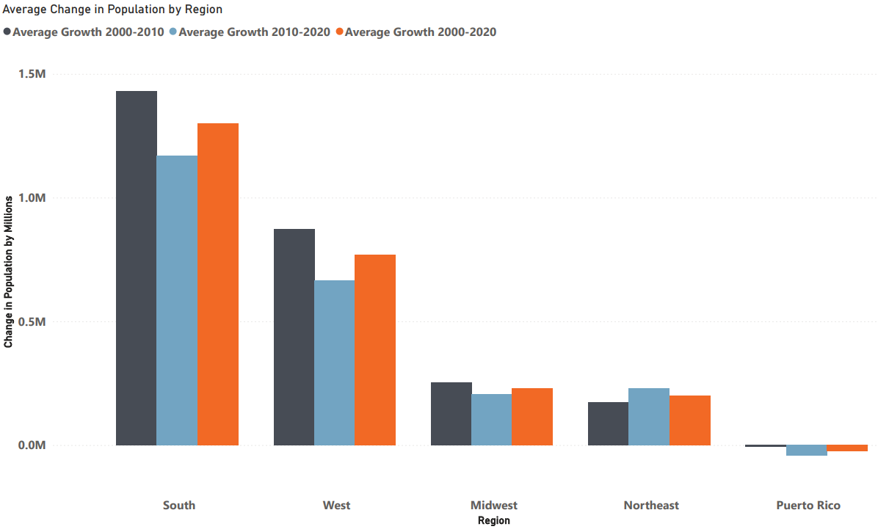
Areas of Decreasing Population
Southern avg. population growth fell by ~20% in 2010-2020
Western avg. population growth fell by ~25% in 2010-2020

Slide 33
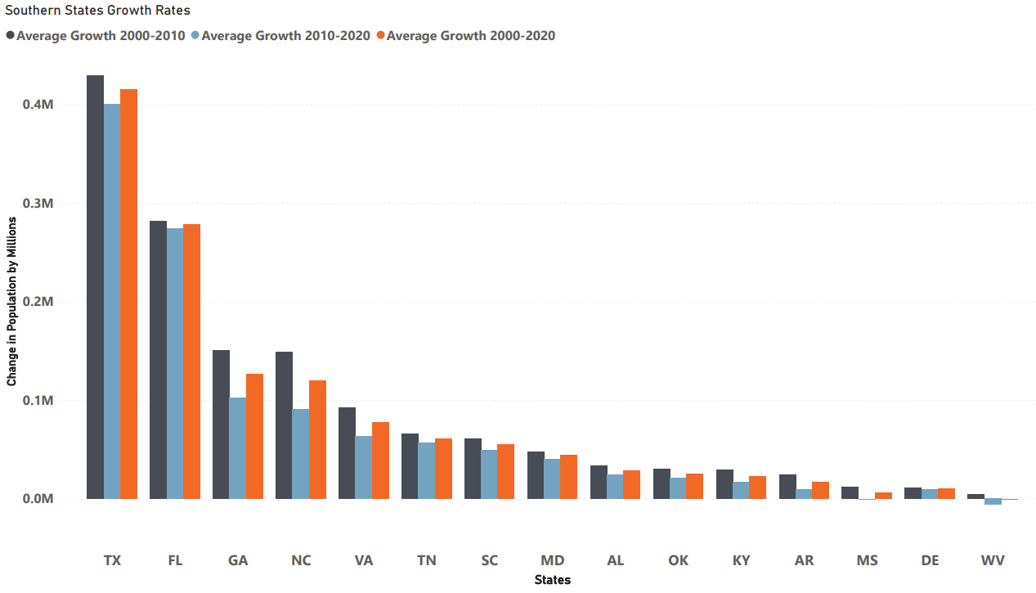
Areas of Decreasing Population
In the Southern states there is dip in growth rates for all but Louisiana
14 of these have slowed by >10%
8 of these have slowed by >20%
West Virginia and Mississippi are the two states with falling populations in the South
Only Louisiana had an increasing growth rate

Slide 34
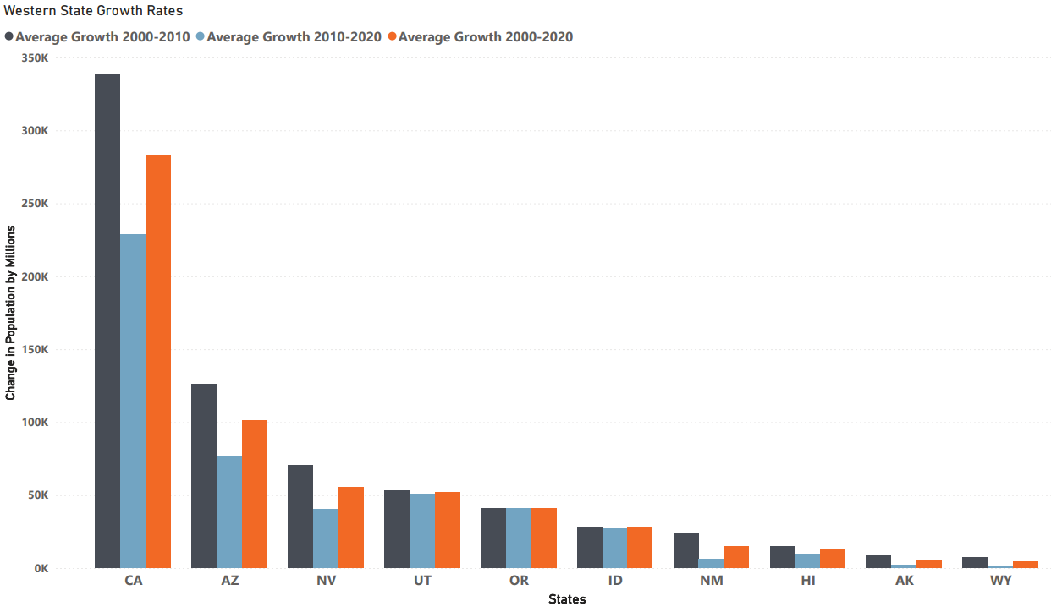
Areas of Decreasing Population
In Western states there are large dips in the more populated states and less overall decrease
California slowed by 32.5%
Arizona slowed by 20%
Nevada slowed by 42.5%
Wyoming, Arkansas, and New Mexico also had falls of >70%, but account for much less of the overall growth

Slide 35
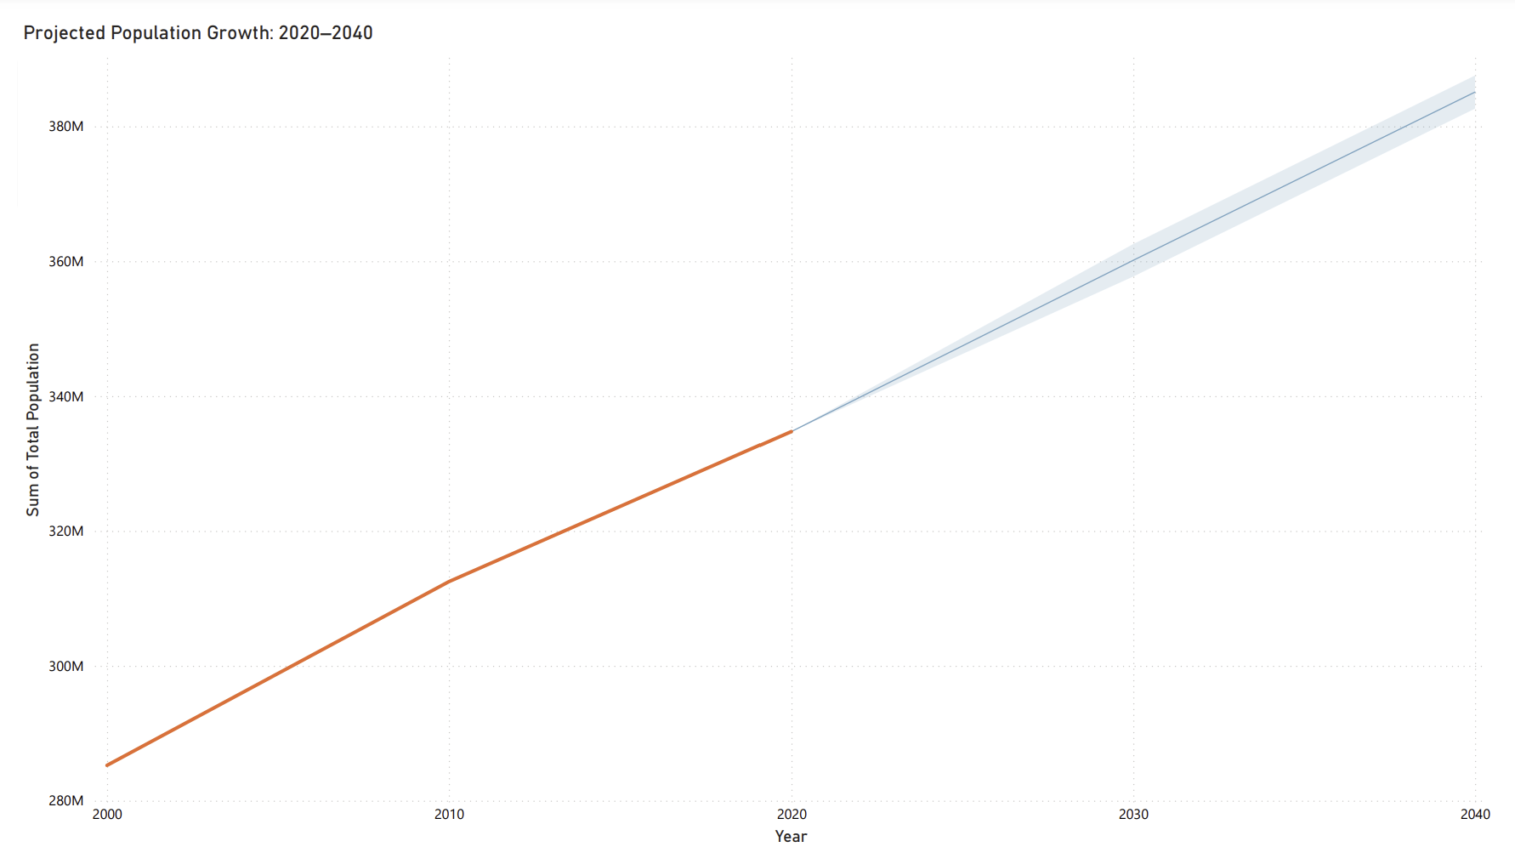
Projected Population Growth

Slide 36
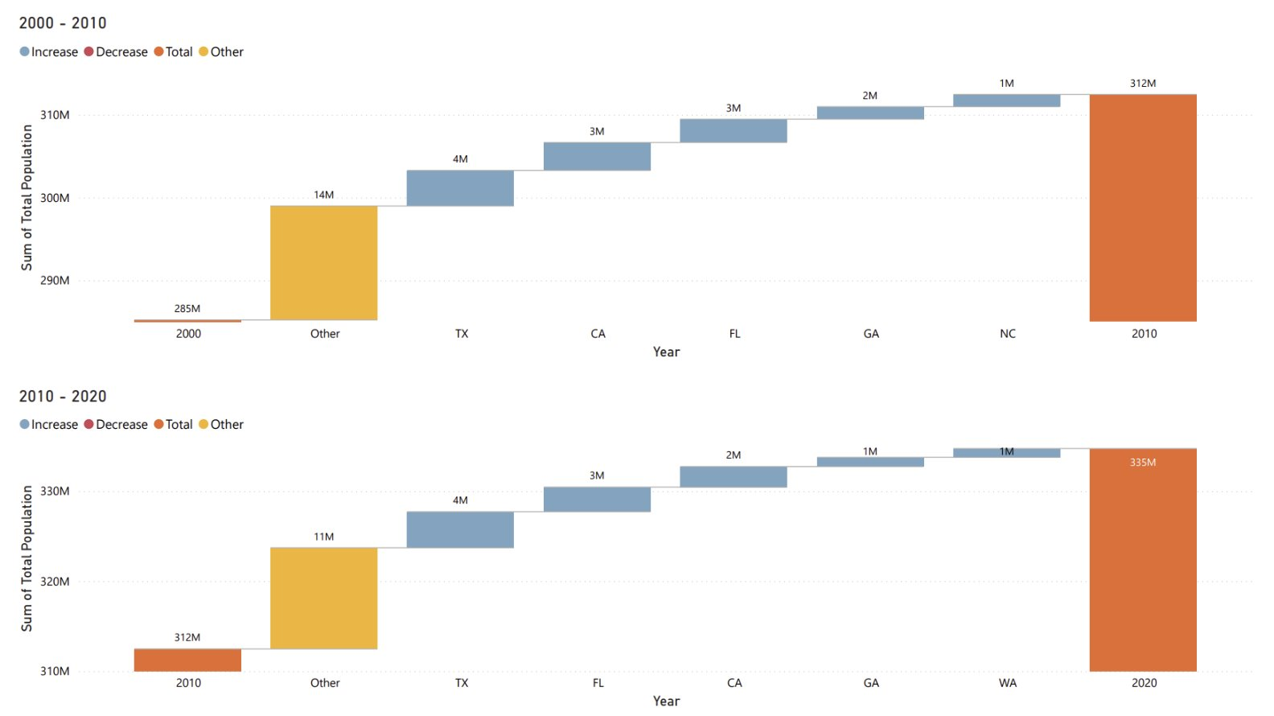
Top States Contributing to U.S. Population Changes (2000–2020)

Slide 37
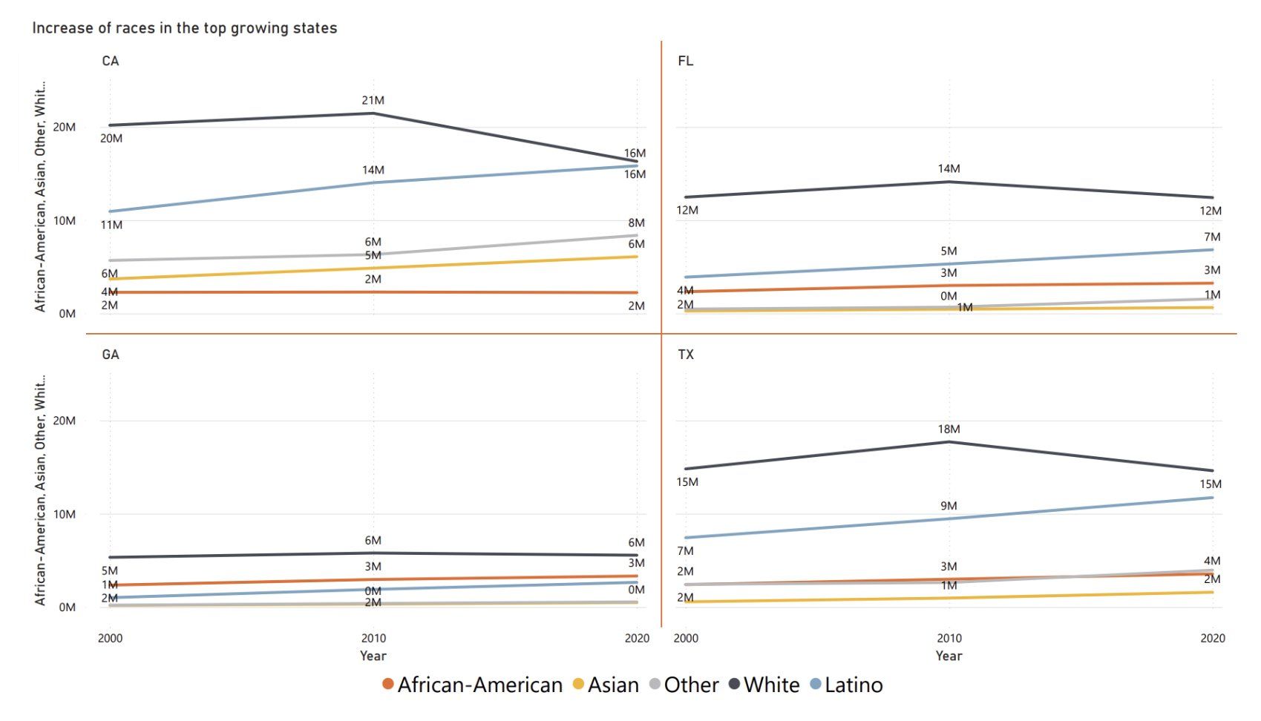
Population Growth by Race in the Leading 4 States (2000–2020)

Slide 38
Retrospective

Slide 39

Retrospective
Major skills were tested
Python
Data collection & cleaning
Spark
Reading, cleaning, and saving
AWS S3
Storage & retrieval
Big scale teamwork
Scrum

Slide 40
Questions?
Questions?

